Slide 1
Machine Learning with Scikit–Learn

Slide 2
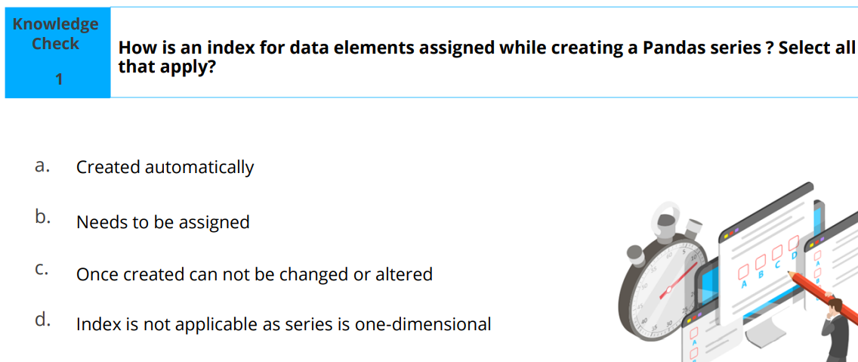
RECAP

Slide 3
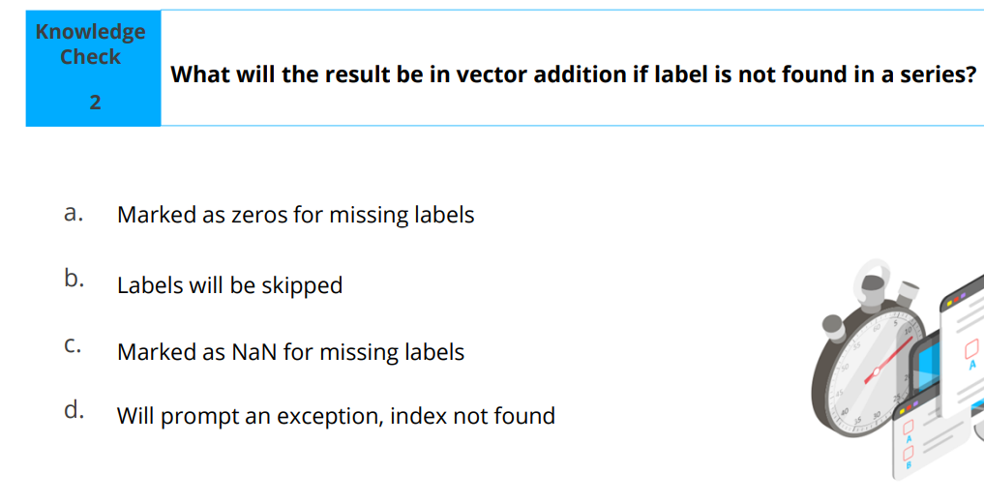

Slide 4
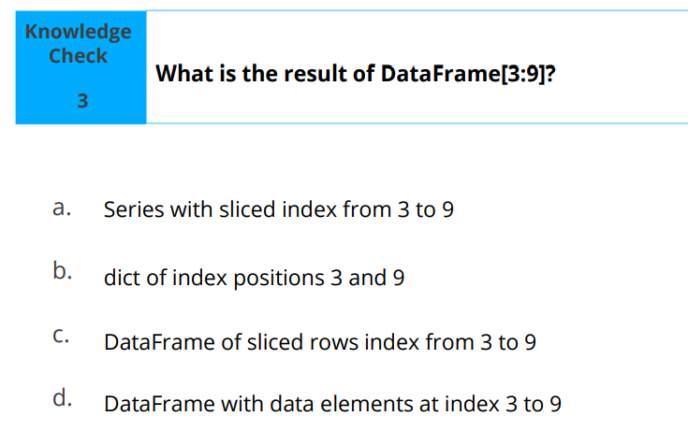

Slide 5
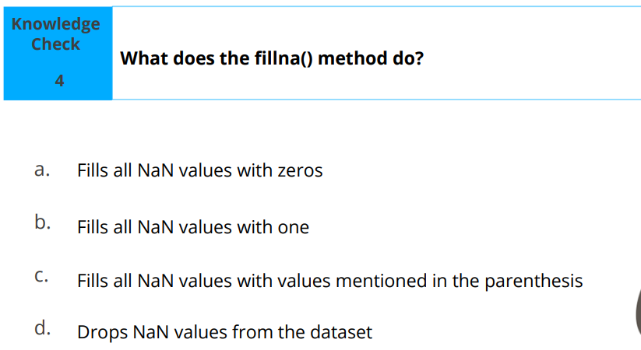

Slide 6
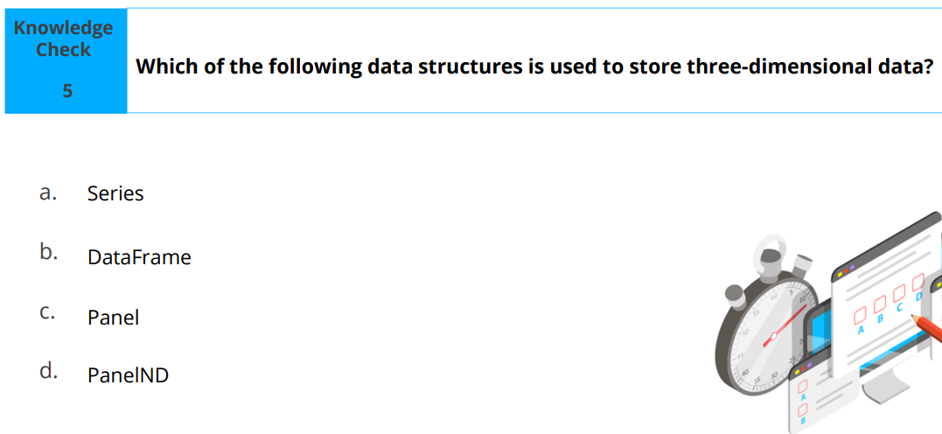

Slide 7
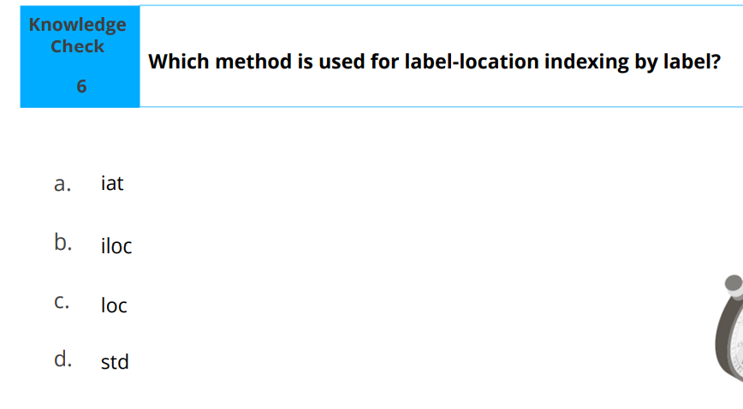

Slide 8
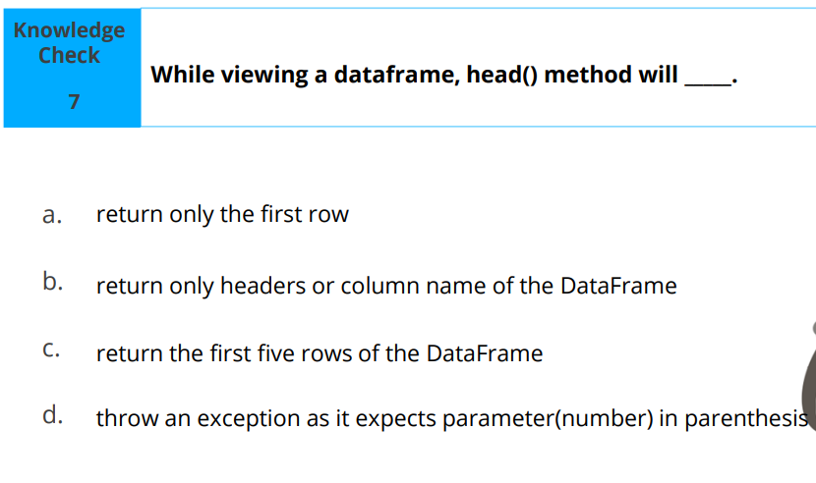

Slide 9
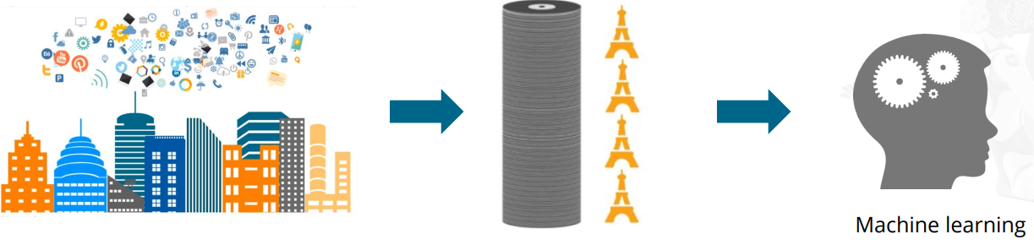
Why Machine Learning
If we stored the data generated in a day on Blu-ray disks and stacked them up, it would be equal to the height of four Eiffel towers.
Machine learning helps analyze this data easily and quickly.

Slide 10

The Eiffel Tower

Slide 11
FUN FACTS
The Eiffel Tower was built in two years, two months, and five days—a record back in the late 1880s. It was officially completed on March 31, 1889.
It was only supposed to last for 20 years. Gustave Eiffel had it built specifically to celebrate the 100th anniversary of the French Revolution.
3. It hasn't always been brown. It was briefly painted yellow in 1889, and from 1954 to 1961, it was painted a brownish-red color.
4. In the late 1920s and early 1930s, the Eiffel Tower acted as a billboard—three of its sides held advertisements for Citroën automobiles. No other brand has ever used the monument as an advertising medium.
5. The French originally hated it. A number of high-profile creatives and architects signed a petition to protest the tower during its construction. They called the tower "useless" and "monstrous."
6. It played a crucial role in the First World War, during the Battle of the Marne in 1914. Signals would be sent out from the top of the tower, directing the French troops to the front line

Slide 12
Machine Learning and terminologies
Machine learning is a great tool to analyze data, find hidden data patterns and relationships, and extract information to enable information-driven decisions and provide insights.
These are some machine learning terminologies that you will come across in this lesson:
Inputs
Attributes
Records
Examples
Label
Outcome
Target
Sample

Slide 13
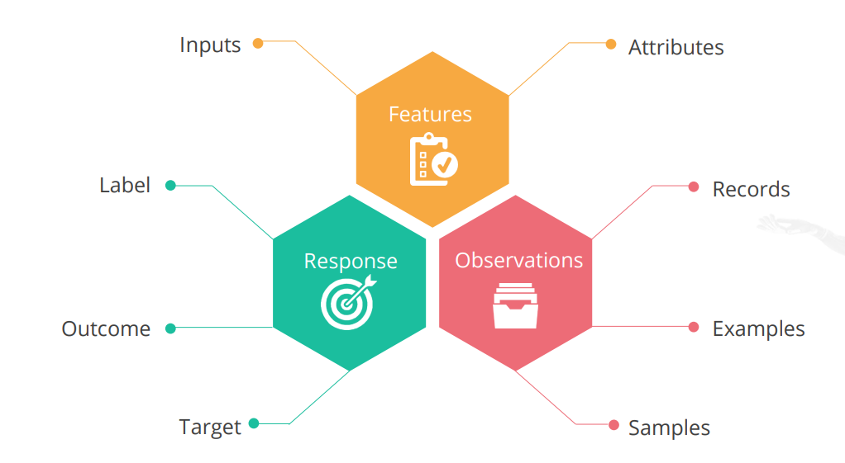

Slide 14
Machine Learning Approach
The machine learning approach starts with either a problem that you need to solve or a given dataset that you need to analyze
Understand the problem/dataset
Extract the features from the dataset
Identify the problem type
Choose the right model
Train and test the model
Strive for accuracy

Slide 15
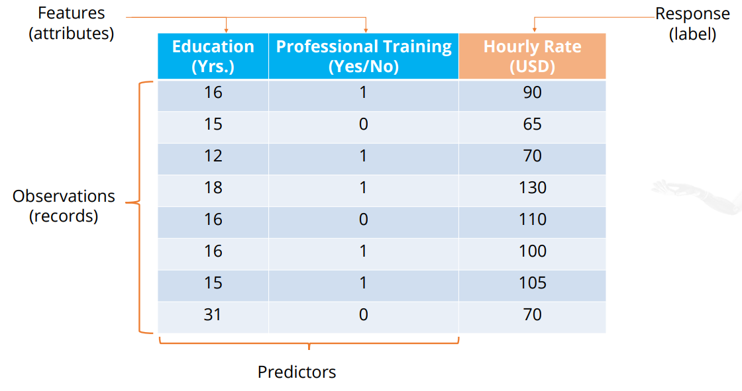
Steps 1 and 2: Understand the Dataset and Extract Its Features

Slide 16
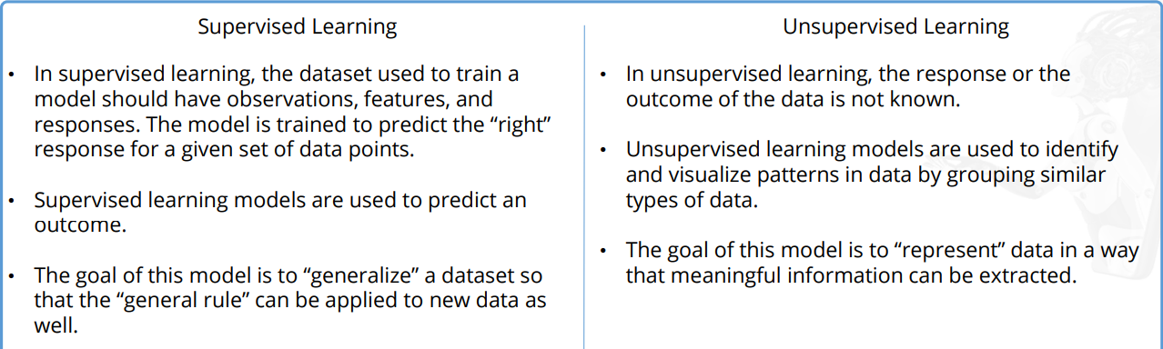
Steps 3 and 4: Identify the Problem Type and Learning Model
Machine learning can either be supervised or unsupervised. The problem type should be selected based on the type of learning model.

Slide 17
PROBLEM TYPES
SUPERVISED LEARNING
Regression: This is a technique for investigating the relationship between independent variables or features and a dependent variable or outcome
Classification: This is defined as the process of recognition , understanding and grouping of objects and ideas into preset categories
UNSUPERVISED LEARNING
Dimensionality reduction: This is a technique for reducing the amount of random variables in a problem by obtaining a set of principal values
Clustering: This is the task of grouping a set of objects in such a way that objects in the same group are more similar to each other than to those in other groups(clusters).

Slide 18
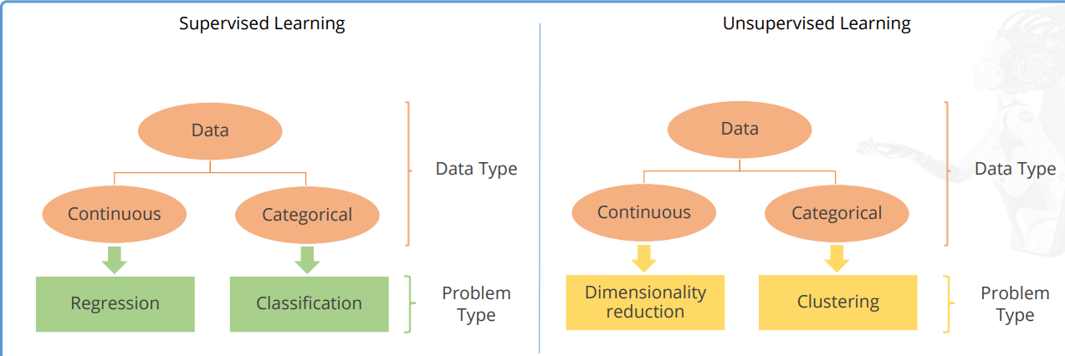

Slide 19
Categorical vs Continuous Data Type
Categorical variables, aka discrete variables: These come in only a fixed number of values – like dead/alive, obese/overweight/normal/underweight.
Continuous variables: These can have any value between a theoretical minimum and maximum, like birth weight, BMI, temperature, neutrophil count.

Slide 20
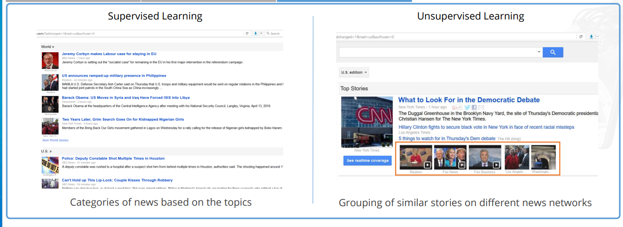
Examples

Slide 21
Working of Supervised and Unsupervised Learning Model
In supervised learning, a known dataset with observations, features, and response is used to create and train a machine learning algorithm. A predictive model, built on top of this algorithm, is then used to predict the response for a new dataset that has the same features.
In unsupervised learning, a known dataset has a set of observations with features. But the response is not known. The predictive model uses these features to identify how to classify and represent the data points of new or unseen data.

Slide 22
Steps 5 and 6: Train, Test, and Optimize the Model
To train supervised learning models, data analysts usually divide a known dataset into training and testing sets.
About 60% to 80% of the data is trained while 20% to 40% of the data is tested

Slide 23
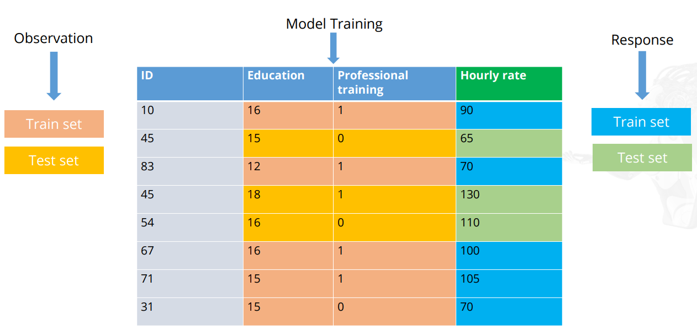

Slide 24
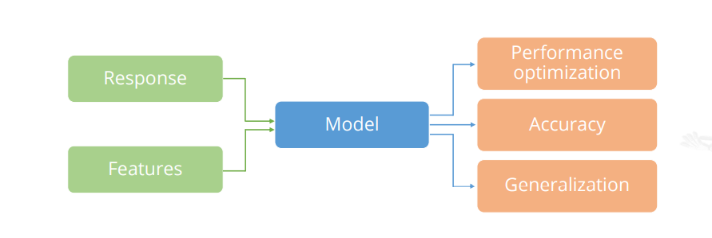
Machine Learning Model Considerations
Some considerations of supervised and unsupervised learning models are shown here.

Slide 25
Scikit-Learn
Scikit is a powerful and modern machine learning Python library for fully and semi automated data analysis and information extraction. It has the following attributes:
Efficient tools to identify and organize problems(Supervised/ Unsupervised)
Free and open datasets
Model persistence
Rich set of libraries for learning and predicting
Model support for every problem type
Open source community and vendor support

Slide 26
Scikit-Learn: Problem-Solution Approach
Below is a step by step approach in solving problems using scikit
Model Selection
Estimator Object
Model Training
Predictions
Model Tuning
Accuracy

Slide 27
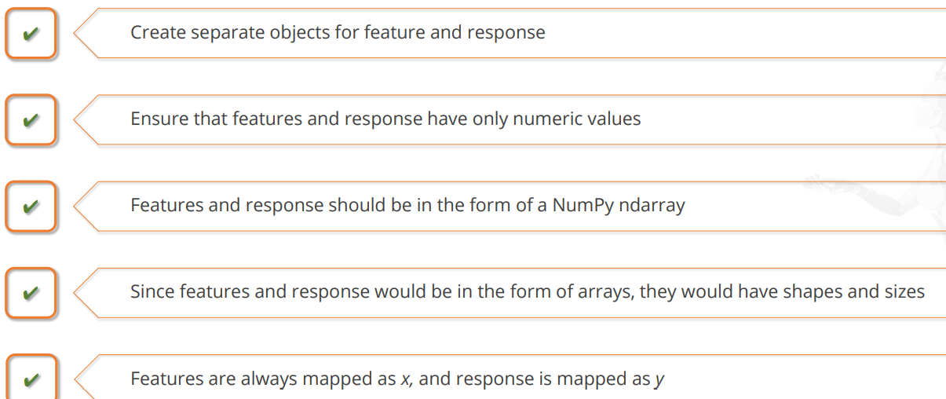
Scikit-Learn: Problem-Solution Considerations

Slide 28
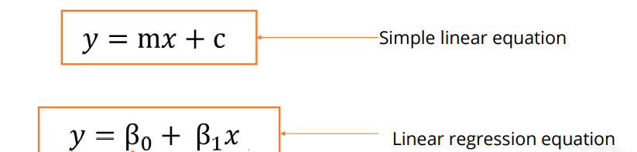
Supervised Learning Models: Linear Regression
Linear regression is a supervised learning model used to analyze continuous data.
It is the most basic and widely used technique to predict a value of an attribute
It is easy to use as the model does not require a lot of tuning
It runs very fast, which makes it more time-efficient
The linear regression equation is based on the formula for a simple linear equation.

Slide 29
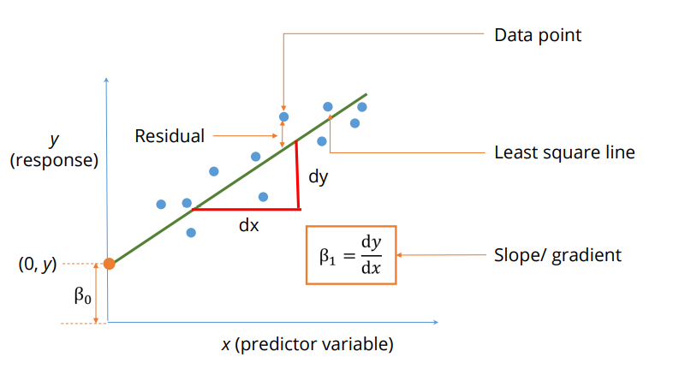

Slide 30
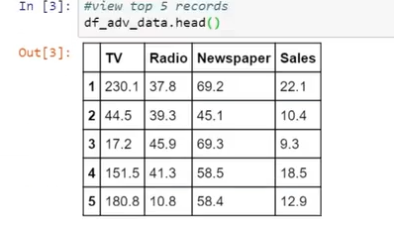
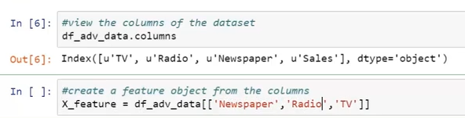
For instance a dataset with the following observation as below

Slide 31


Slide 32
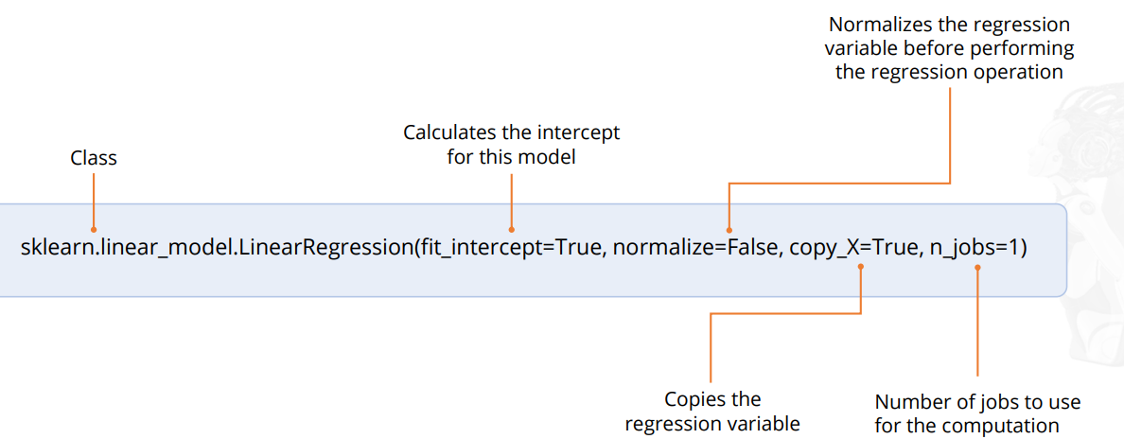
How Scikit works

Slide 33
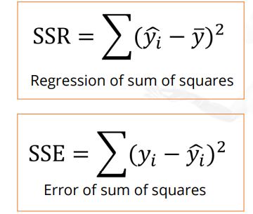
Smaller the value of SSR or SSE, the more accurate the prediction will be, which would make the model the best fit.

Slide 34
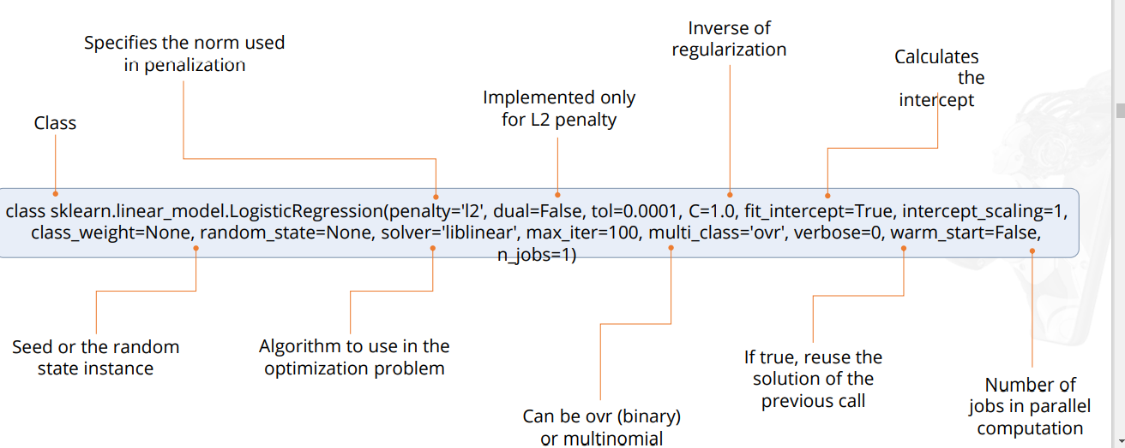
Supervised Learning Models: Logistic Regression

Slide 35
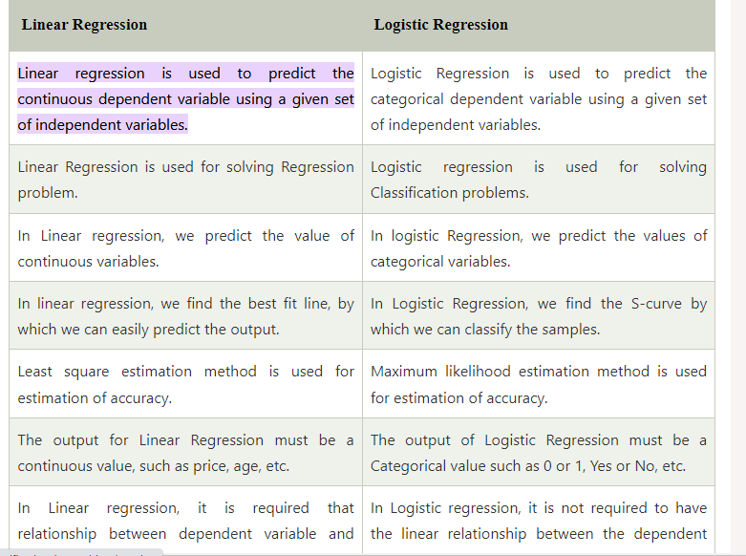

Slide 36
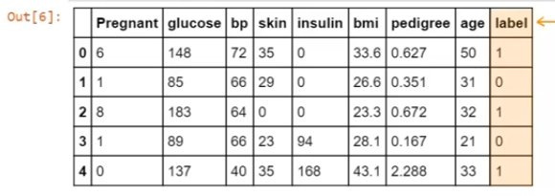
Logistic regression

Slide 37
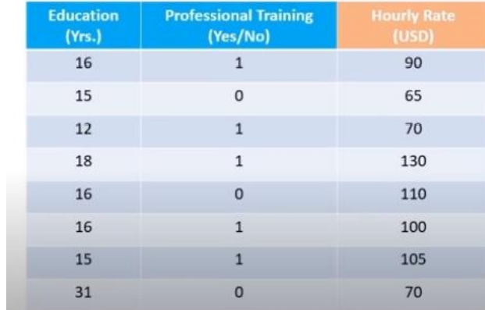
Supervised Learning Models: : K-Nearest Neighbors
K-Nearest Neighbors, or K-NN, is one of the simplest machine learning algorithms used for both classification and regression problem types.

Slide 38
K-means finds the best centroids by alternatively assigning random centroids to a dataset and selecting mean data points from the resulting clusters to form new centroids. It continues this process iteratively until the model is optimized.

Slide 39
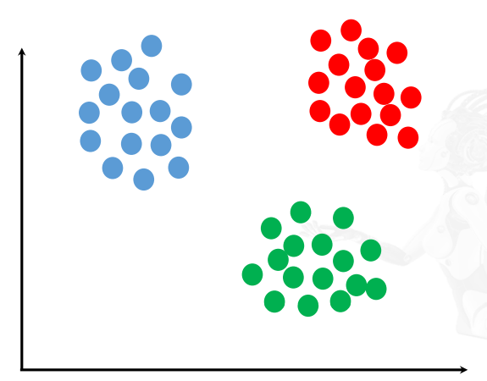
Unsupervised Learning Models: Clustering
A cluster is a group of similar data points.
Clustering is used to:
• Extract the structure of the data
• Identify groups in the data

Slide 40
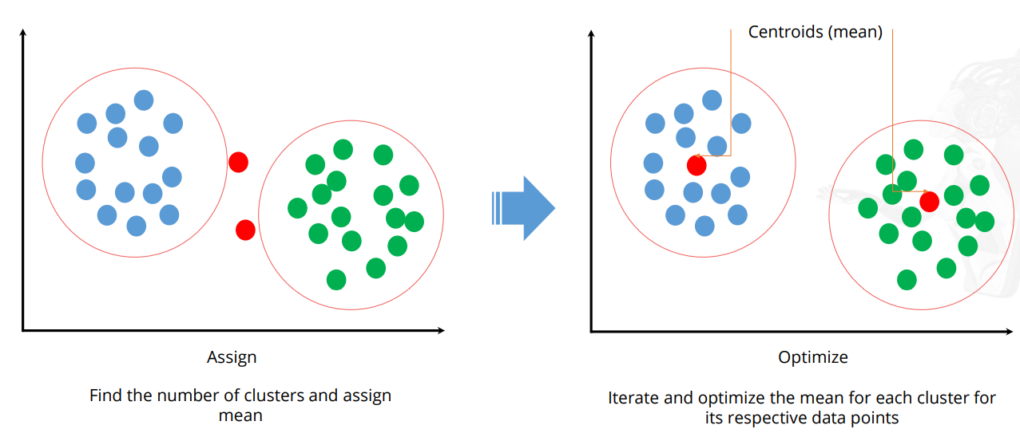

Slide 41
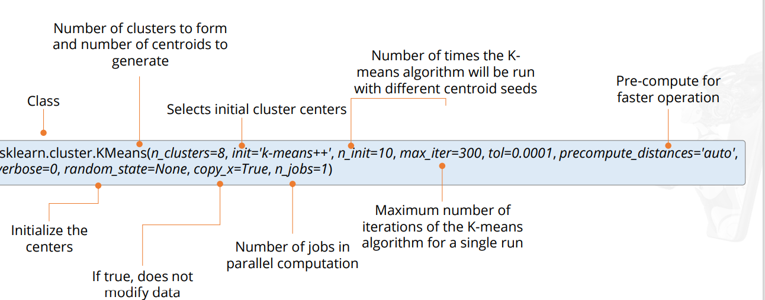

Slide 42
Unsupervised Learning Models: Dimensionality Reduction
It reduces a high-dimensional dataset into a dataset with fewer dimensions. This makes it easier and faster for the algorithm to analyze the data.
These are some techniques used for dimensionality reduction especially for a Large dataset(a few thousand columns and rows)
Drop data columns with missing values
Drop data columns with low variance
Drop data columns with high correlations
Apply statistical functions - PCA

Slide 43
Unsupervised Learning Models: Principal Component Analysis
It is a linear dimensionality reduction method which uses singular value decomposition of the data and keeps only the most significant singular vectors to project the data to a lower dimensional space.
• It is primarily used to compress or reduce the data.
• PCA tries to capture the variance, which helps it pick up interesting features.
• PCA is used to reduce dimensionality in the dataset and to build our feature vector.
• Here, the principal axes in the feature space represents the direction of maximum variance in the data.

Slide 44
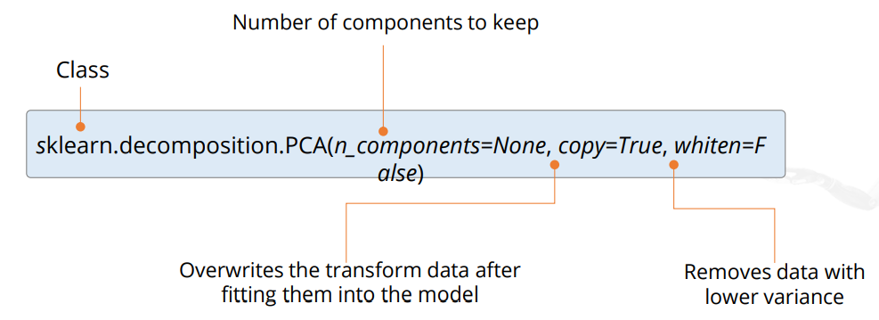
How the PCA algorithm works

Slide 45
Model Persistence
You can save your model for future use. This avoids the need to retrain the model.
• This can be saved using the Pickle method.
• It can also be replaced with the joblib of Sci-kit team.
• Both joblib.dump and joblib.load can be used.
• These would be efficient for Big Data

Slide 46
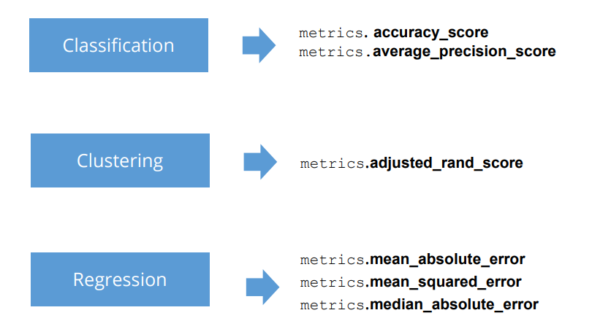
Model Evaluation: Metric Functions
You can use the “Metrics” function to evaluate the accuracy of your model’s predictions.

Slide 47
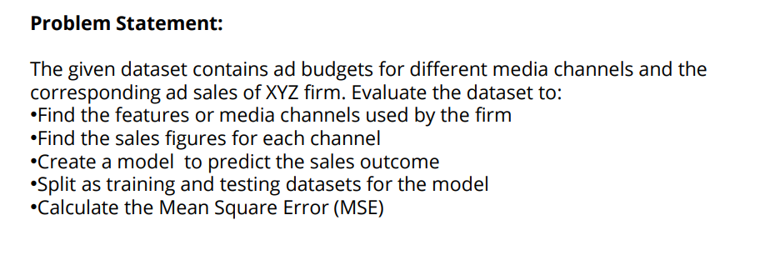
Advertising Budget and Sales

Slide 48
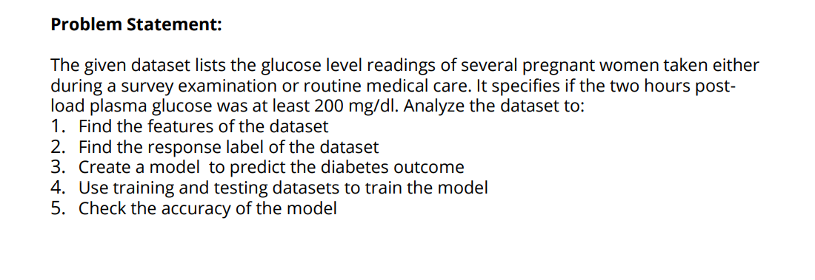
Diabetes Prediction

